Slide 1
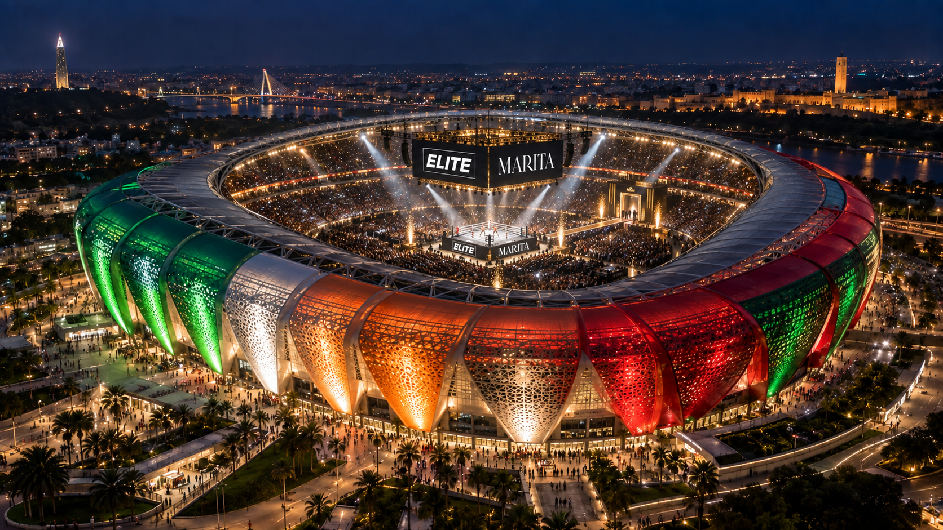

Slide 2
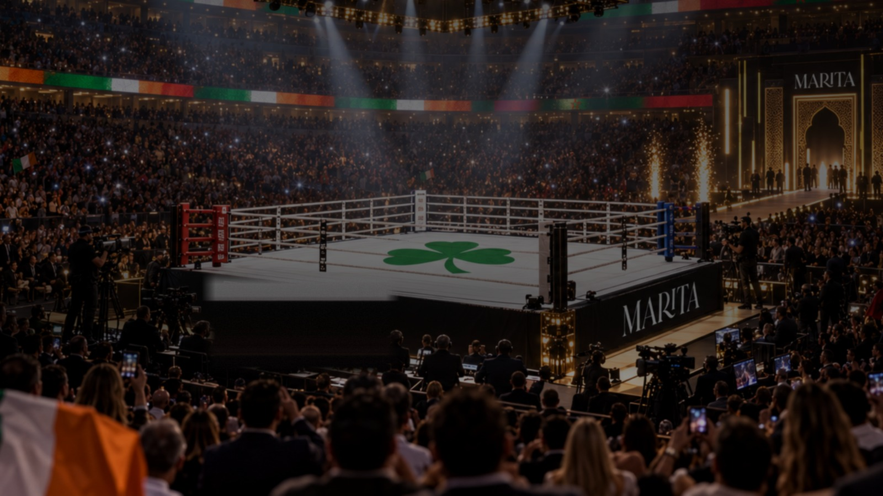


SPORTS PROMOTIONS ×
GROUP
A PROPOSAL TO THE KINGDOM OF MOROCCO
NIGHT OF CHAMPIONS
RABAT · 2027
A world-level championship fight card and stadium music spectacle — Prince Moulay Abdellah Stadium · 67,700 fans
PROMOTED BY ELITE SPORTS PROMOTIONS & MARITA GROUP
PRIVATE & CONFIDENTIAL

Slide 3
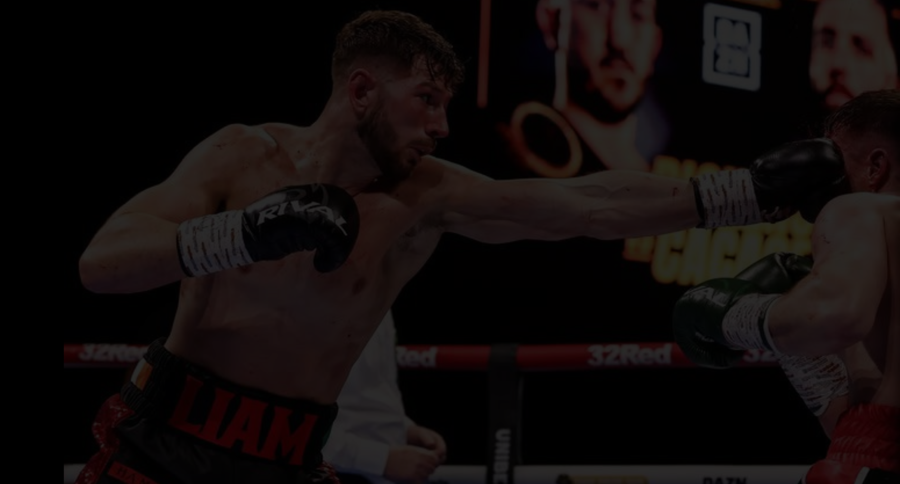

THE OPPORTUNITY
A WORLD-CLASS SHOW, BUILT FOR RABAT
An opportunity has opened, through the Marita Group, to bring Elite's stadium boxing show to Rabat — a world-level fight card fused with stadium-scale music, staged for a 67,700 crowd.
The Marita Group is one of Morocco's most prestigious business groups, bringing direct Government relationships and funding support. Elite brings the fights, the artists and the broadcast machine.
67,700
CAPACITY CROWD AT PRINCE MOULAY ABDELLAH STADIUM
6
FIFTY-FIFTY FIGHTS ON THE PRO 3 DEBUT CARD
THE PROVEN FORMULA
200
STRONG INTERNATIONAL DELEGATION — FIGHTERS TO BROADCAST CREW
Boxing + music is how you sell out a stadium. A world-level fight card gives the night its sporting credibility; a global headline artist and a world-famous DJ turn it into a national event — and the night hosts the debut of PRO 3 boxing, the most exciting new boxing format in decades.
Detailed financial projections are available to Government partners on request.
ELITE SPORTS PROMOTIONS × MARITA GROUP — NIGHT OF CHAMPIONS · RABAT

Slide 4
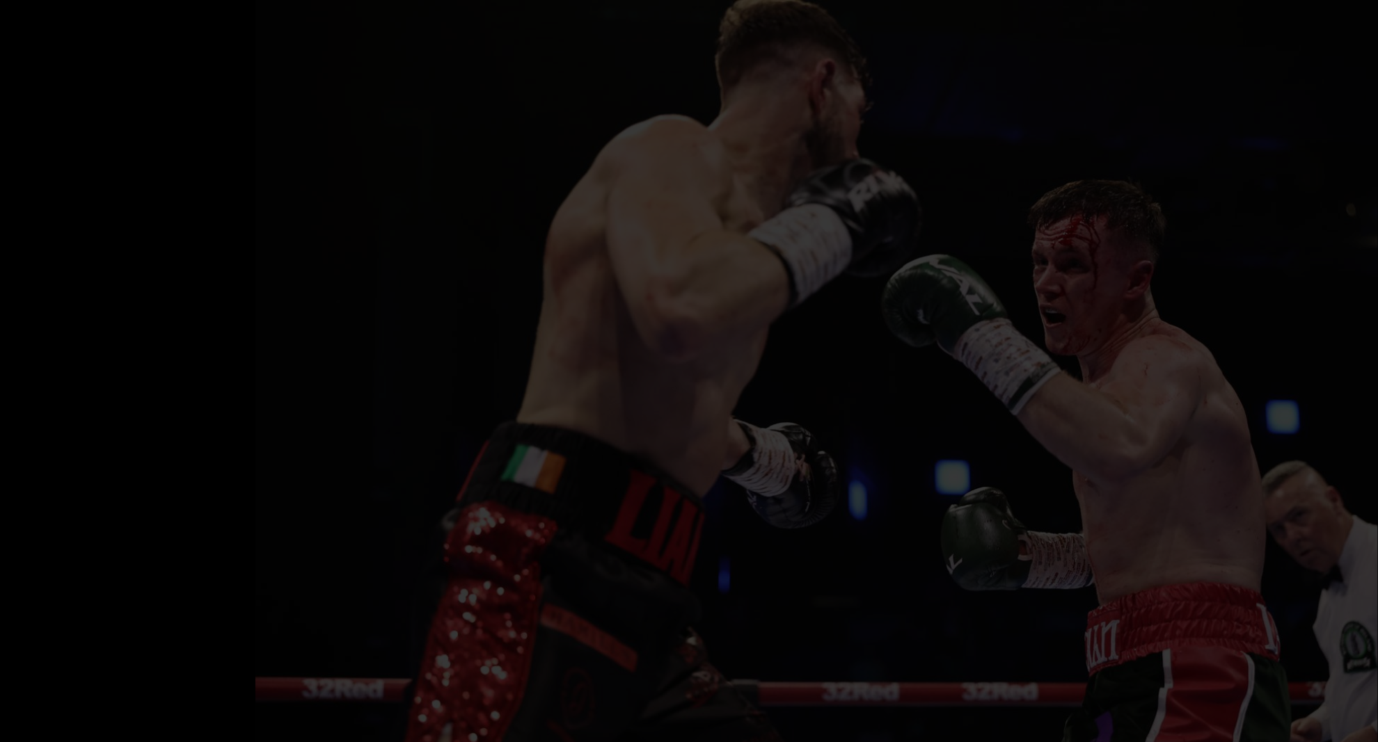
THE STRATEGIC CASE
WHY MOROCCO, WHY NOW
26M
~20M
2030
TOURISM AMBITION
RECORD MOMENTUM
WORLD CUP PLATFORM
Tourists targeted by 2030 under Morocco's national tourism vision.
Visitors welcomed in a record-breaking 2025, according to the Tourism Ministry.
Morocco co-hosts the 2030 FIFA World Cup and is building a lasting major-event legacy.
A 2027 Night of Champions sits exactly between Morocco's tourism acceleration and the 2030 World Cup — a commercially driven test of stadium operations, broadcast storytelling, hospitality and international audience conversion, staged on a national asset the Kingdom already owns.
The proposition: convert event support into measurable tourism, local procurement, employment and destination exposure — and create a repeatable annual property that strengthens Rabat's major-event credentials ahead of 2030.
ELITE SPORTS PROMOTIONS × MARITA GROUP — NIGHT OF CHAMPIONS · RABAT

Slide 5
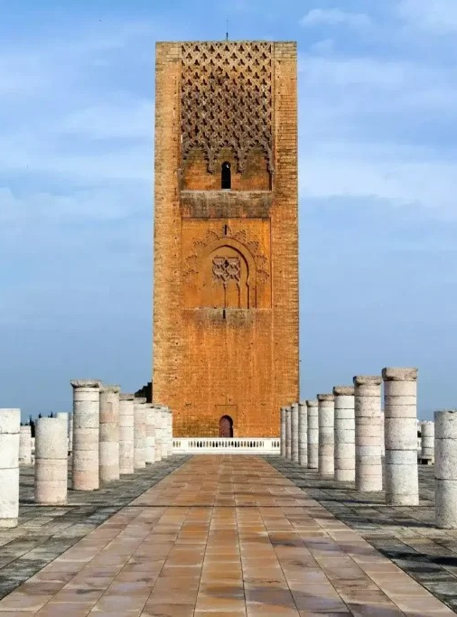
THE HOST CITY
WHY RABAT,
WHY NOW
A brand-new national icon. The 67,700-seat Prince Moulay Abdellah Stadium — the Kingdom's newly rebuilt national arena — is an awesome stage for a live concert and a world title fight alike.
A proven live-music market. Robbie Williams recently played to a huge response in Morocco — the country turns out in force for global acts, and we hold an existing relationship with his management.
Built-in access at the highest level. The Marita Group's direct Government contacts de-risk venue, security, aviation and broadcast negotiations — the items that normally take promoters years.
ELITE SPORTS PROMOTIONS × MARITA GROUP — NIGHT OF CHAMPIONS
HASSAN TOWER · RABAT

Slide 6
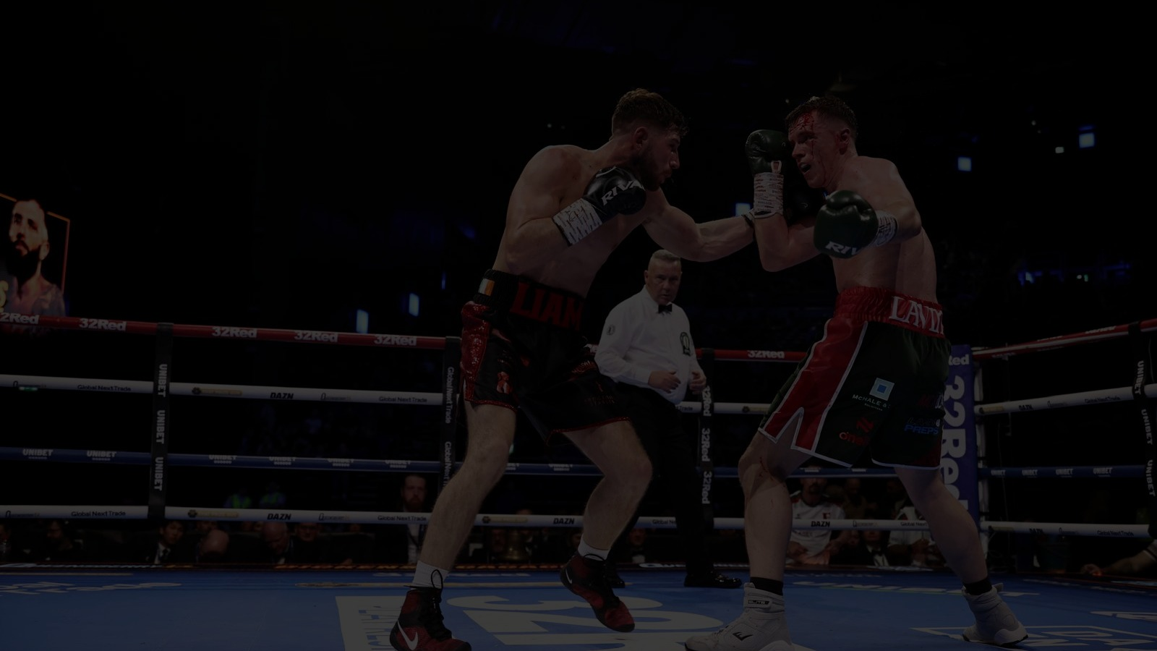
ELITE
THE EVENT CONCEPT
TWO SPECTACLES. ONE NIGHT.
The fight card delivers the sporting drama; the music carries the night past the final bell — and carries ticket sales past 67,700.
PART ONE — THE FIGHTS
PART TWO — THE MUSIC
World-level headline fight — the main event, contested at genuine world level
Two co-main events — strength in depth beneath the headline
PRO 3 launch — six evenly matched 50-50 fights debuting the most exciting new boxing format in decades — pro3boxing.com
Four-fight undercard — a full evening from first bell
+
Robbie Williams — global headline set; a proven draw in Morocco, with a direct line to his management
Charlotte de Witte — the world's leading techno DJ closes the night after the final bell
Full stadium staging — purpose-built music production on the pitch
ONE TICKET
ONE STADIUM
THE FORMULA: boxing's core audience buys for the card — the general public buys for the artists. Together they fill a 67,700-seat stadium.
ELITE SPORTS PROMOTIONS × MARITA GROUP — NIGHT OF CHAMPIONS · RABAT

Slide 7
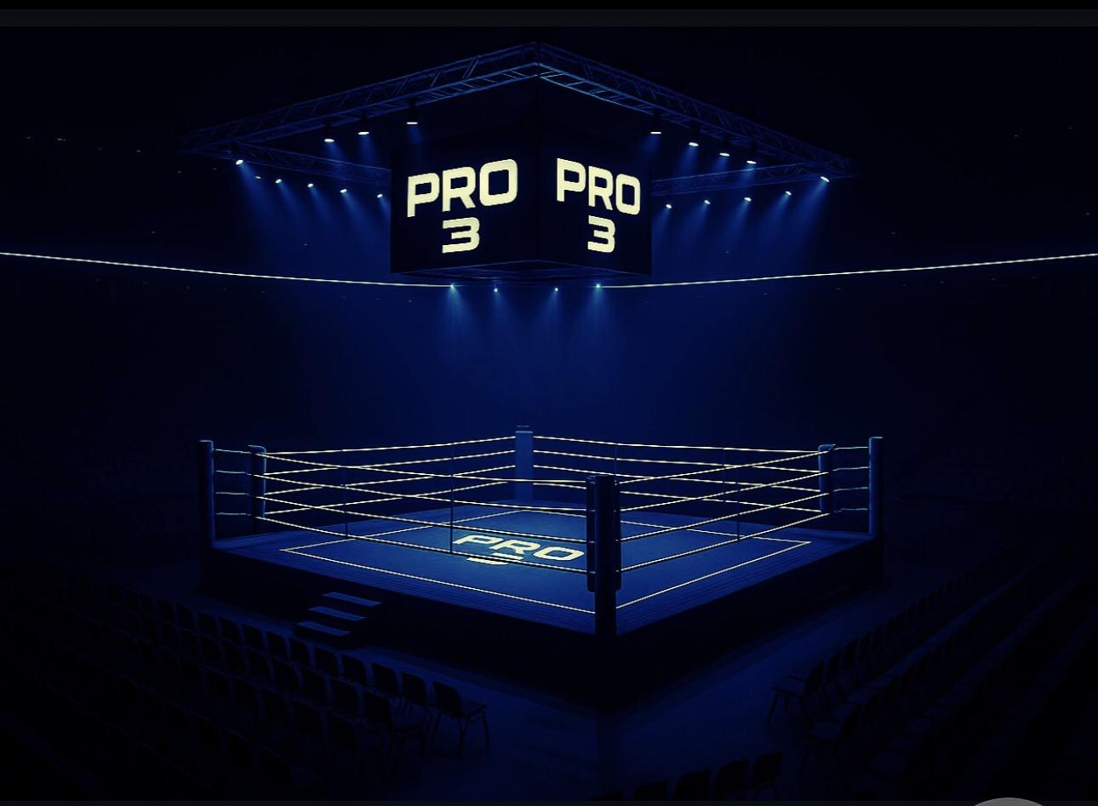
ELITE
THE FIGHT CARD
BUILT FOR WORLD LEVEL
BOUT TIER | DETAIL
Headline | World-level main event
Co-mains ×2 | 2 world-level co-main fights
PRO 3 launch ×6 | Six evenly matched 50-50 fights
Undercard ×4 | 4 fights showcasing rising talent
THE FULL CARD — 13 BOUTS ON ONE NIGHT
THE LAUNCH OF PRO 3
PRO 3 debuts on this card with six evenly matched 50-50 fights — no mismatches, no foregone conclusions — and gets its own show presentation inside the stadium.
SANCTIONING & OFFICIATING: the show is officiated by the Boxing Union of Ireland (BUI), with three full paramedic crews ringside — each led by a senior paramedic.
ELITE SPORTS PROMOTIONS × MARITA GROUP — NIGHT OF CHAMPIONS · RABAT

Slide 8
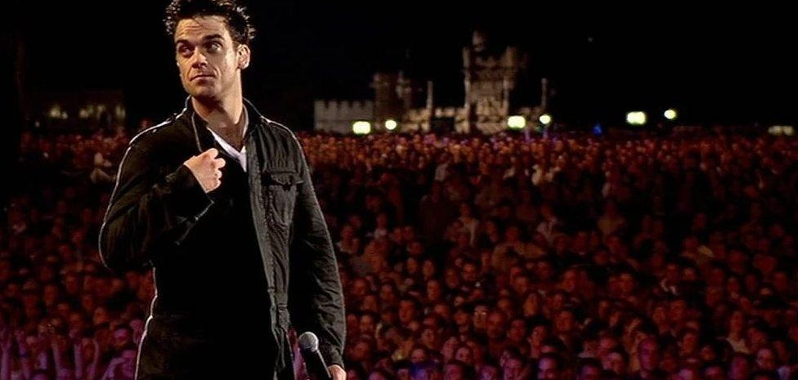
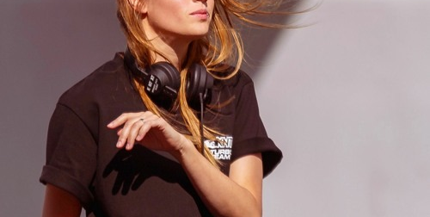
ELITE
THE MUSIC
THE SOUNDTRACK OF THE NIGHT
ROBBIE WILLIAMS
CHARLOTTE DE WITTE
The headline set. One of the world's great stadium performers — and a proven success in Morocco, where he recently played to a huge response. Elite holds an existing relationship with his management.
The after-fight set. The world's leading techno DJ takes over the stadium after the final bell — turning a fight night into a full-scale music event and driving the younger ticket-buying audience.
ELITE SPORTS PROMOTIONS × MARITA GROUP — NIGHT OF CHAMPIONS · RABAT
IMAGES FOR PROPOSAL ILLUSTRATION ONLY

Slide 9
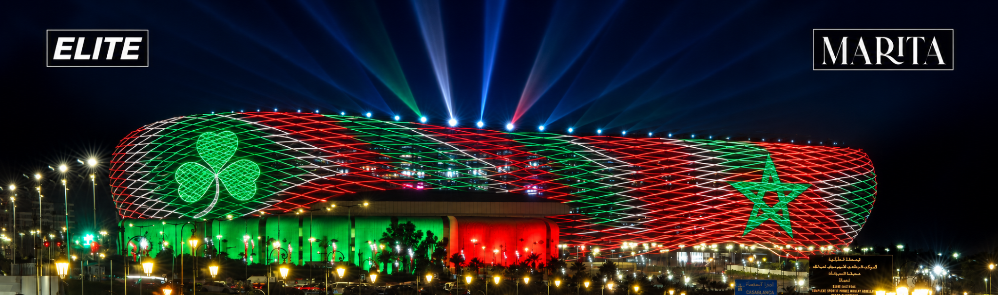
THE VENUE
PRINCE MOULAY ABDELLAH — THE NATIONAL STAGE
A four-week training camp on site. The stadium offers facilities and accommodation for boxers and teams (to be confirmed by inspection) — turning the build-up itself into a month of marketing.
67,700
Newly rebuilt for the Kingdom. Morocco's national stadium, reopened in 2025 — a world-class bowl built for the biggest nights in sport and music.
CAPACITY WITH PITCH SEATING AND A PURPOSE-BUILT MUSIC STAGE
An awesome spectacle for a live concert. Modern acoustics, full-bowl sightlines and concert-grade production — the fight night and the festival in one.
ELITE SPORTS PROMOTIONS × MARITA GROUP — NIGHT OF CHAMPIONS · RABAT

Slide 10
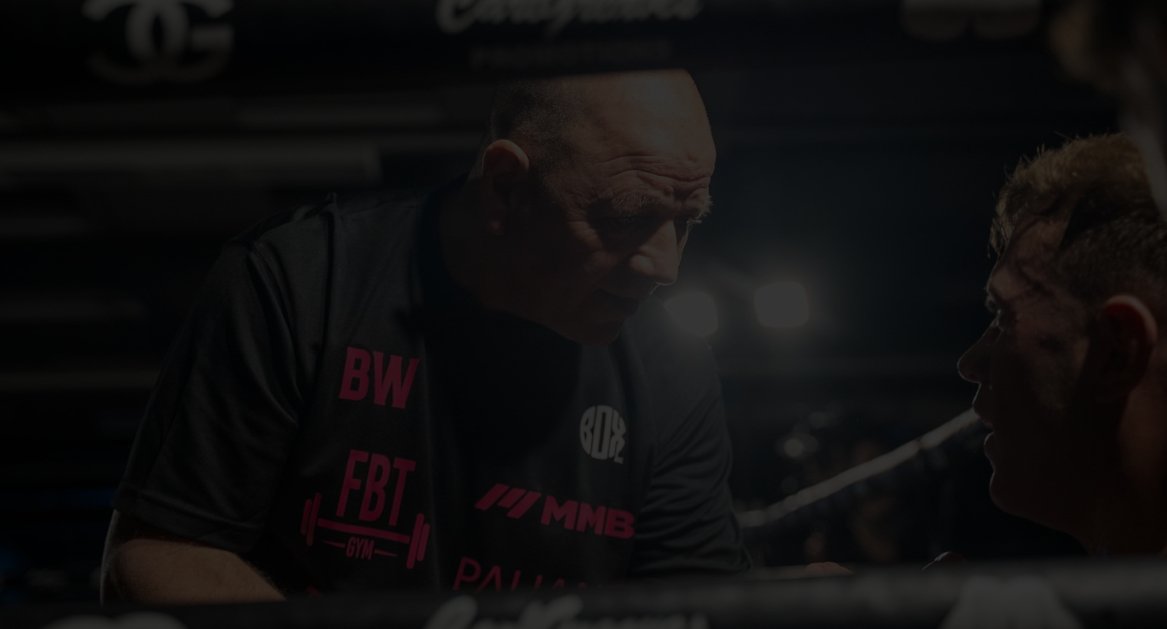
ELITE
BROADCAST & BUILD-UP
RABAT, BEAMED TO THE WORLD
INTERNATIONAL BROADCAST
THE CONTENT ENGINE
FM+ (FMPLUS.music) leads international coverage as the event's main broadcast partner — with Elite in talks with further major broadcasters to extend reach, placing Rabat in front of a global boxing audience.
A four-week on-site fight camp generates a month of daily content — training, face-offs, weigh-ins — marketing the show long before fight night.
HOME BROADCAST
TICKETING
Moroccan sports broadcasters carry the show at home, with Government introductions to open the negotiations — a national event, free to the nation.
Ticket sales run through Ticketmaster — tiered pricing across the 67,700 capacity, built to fill the national stadium on fight night.
ELITE SPORTS PROMOTIONS × MARITA GROUP — NIGHT OF CHAMPIONS · RABAT

Slide 11
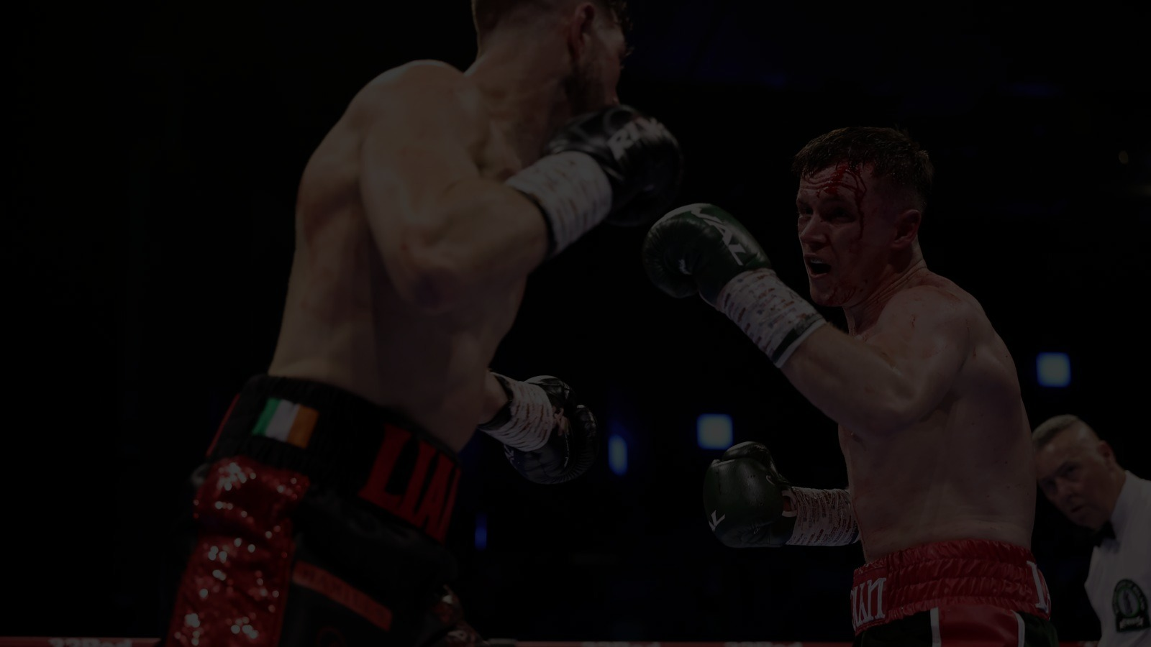
THE CONTENT ENGINE
FOUR WEEKS OF ATTENTION
01
02
03
04
WEEK 1
WEEK 2
WEEK 3
EVENT WEEK
Arrivals · camp opening · Rabat destination content
Training stories · athlete profiles · community activations
Media days · face-offs · sponsor content
Press conference · weigh-in · fight night · music finale
THE GOVERNMENT OPPORTUNITY: a four-week camp converts one night into a month-long media and tourism campaign — coordinate tourism imagery, destination messages and cultural content so international coverage markets Morocco as well as the fight.
ELITE SPORTS PROMOTIONS × MARITA GROUP — NIGHT OF CHAMPIONS · RABAT

Slide 12
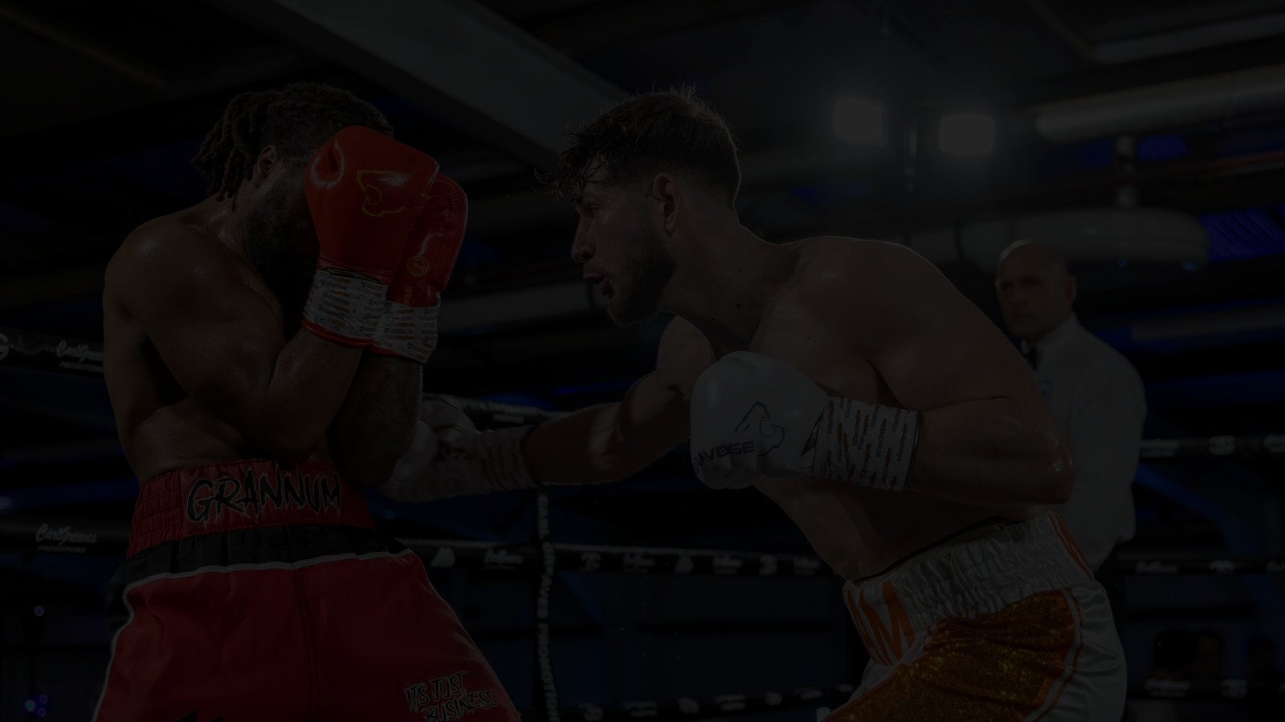
AUDIENCE STRATEGY
FIVE MARKETS. ONE EVENT.
01
02
03
04
05
MOROCCO
DIASPORA
EUROPE
GULF
AFRICA
National sports and music audience — the heart of the 67,700.
France · Spain · Belgium · Netherlands · UK — flying home for fight night.
Short-haul fight and music fans, hours away by air.
Premium sports-travel audience — hospitality and VIP buyers.
Regional media and boxing audience across the continent.
THE COMMERCIAL IMPLICATION: ticketing and media are planned around five distinct customer segments — differentiated ticket bundles, travel packages, language-specific creative, airline partnerships and geo-targeted digital acquisition.
ELITE SPORTS PROMOTIONS × MARITA GROUP — NIGHT OF CHAMPIONS · RABAT

Slide 13
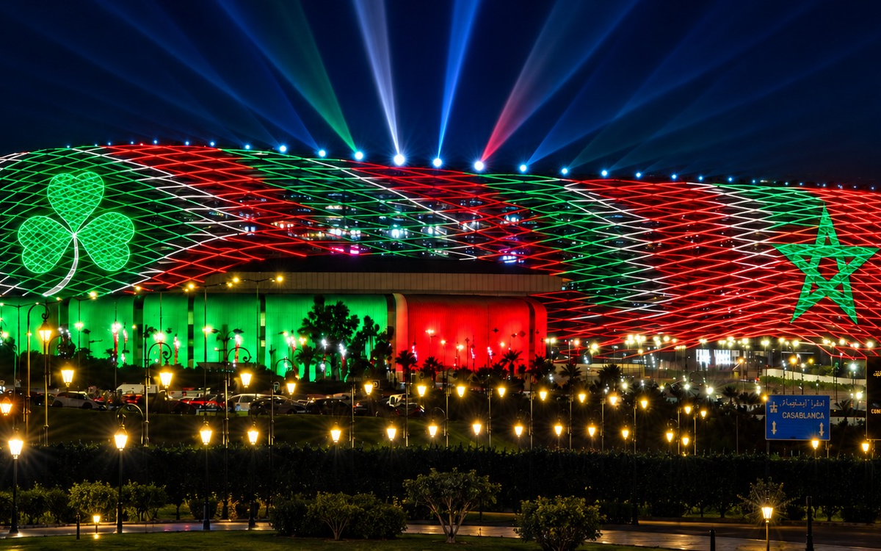
ELITE
THE INVESTMENT
A WORLD-CLASS PRODUCTION, ON A WORLD-CLASS STAGE
WORLD-CLASS FIGHT CARD
Headline main event · two co-main fights · PRO 3 launch — six 50-50 fights · four-fight undercard
MUSIC
Headline artist Robbie Williams · celebrity DJ Charlotte de Witte — a full stadium concert around the fights
PRODUCTION & DELIVERY
Show management & production · 200 hotel rooms for seven nights · 200 return flights · four-week on-site fight camp · marketing · officials, medics & ring
PRINCE MOULAY ABDELLAH STADIUM · RABAT
Every element of the show is delivered by Elite Sports Promotions and the Marita Group — the Kingdom provides the stage, we bring the world.
ELITE SPORTS PROMOTIONS × MARITA GROUP — NIGHT OF CHAMPIONS · RABAT
DETAILED FINANCIALS AVAILABLE TO GOVERNMENT PARTNERS ON REQUEST

Slide 14
ELITE
THE OPPORTUNITY
A HUGE FINANCIAL OPPORTUNITY
BOX OFFICE — VIA TICKETMASTER
SPONSORSHIP — LOCAL BUSINESS
Tiered ticketing across the 67,700-seat national stadium — from accessible general admission to premium ringside — drives a massive one-night box office.
Ticketmaster distribution gives the show full digital reach at home and across Europe, the Gulf and the Moroccan diaspora.
A sell-out crowd means massive tourist income — packed hotels, restaurants and transport across Rabat.
Morocco's leading companies join the night — a lucrative chance for local businesses to stand in front of a stadium of 67,700 and a global broadcast audience.
TARGET PARTNER | SECTOR
Marita Group | Co-promoter
Maroc Telecom | Telecoms
Attijariwafa Bank | Banking
OCP Group | Industry
Marsa Maroc · Managem | Ports · Mining
Massive tourist income. A lucrative platform for local business. A city showcased to millions around the world.
ELITE SPORTS PROMOTIONS × MARITA GROUP — NIGHT OF CHAMPIONS · RABAT
DETAILED FINANCIALS AVAILABLE TO GOVERNMENT PARTNERS ON REQUEST

Slide 15
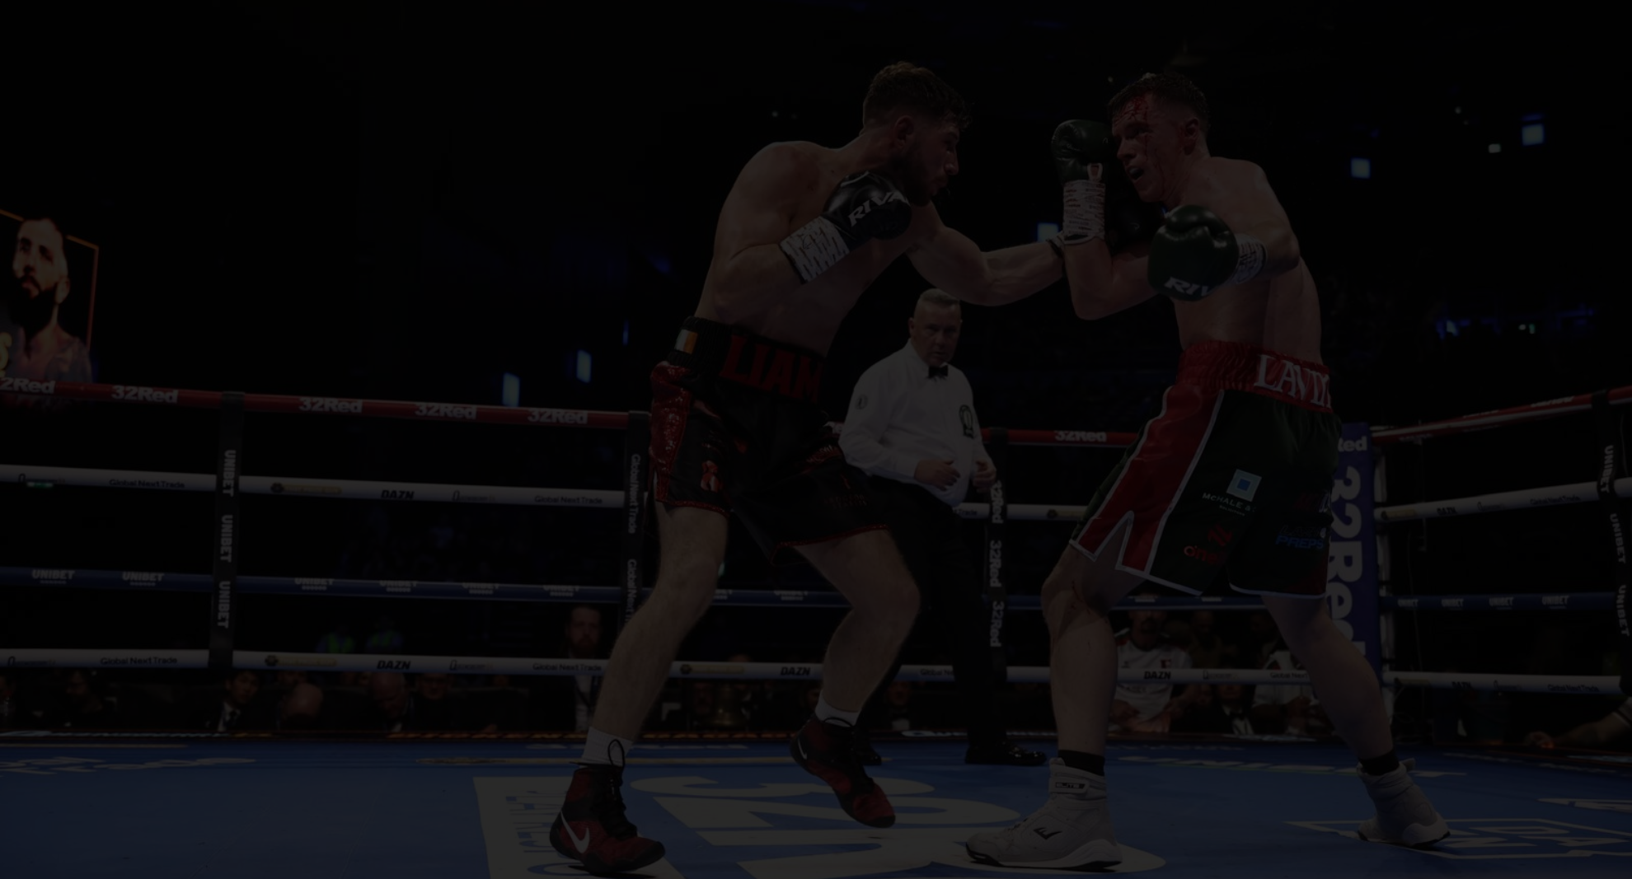
ECONOMIC IMPACT
AN IMPACT MODEL BUILT FOR AUDIT
DIRECT
INDIRECT
Visitor spend · local event procurement · local payroll · transport and hospitality.
Supplier purchases · subcontracting · local business inputs across the delivery chain.
INDUCED
MEDIA VALUE
Household re-spend from wages and supplier income generated by the event.
Destination exposure · brand integrations · earned media — reported separately.
MEDIA VALUE IS REPORTED SEPARATELY FROM GDP-STYLE ECONOMIC IMPACT — NO DOUBLE COUNTING.
ELITE SPORTS PROMOTIONS × MARITA GROUP — NIGHT OF CHAMPIONS · RABAT

Slide 16
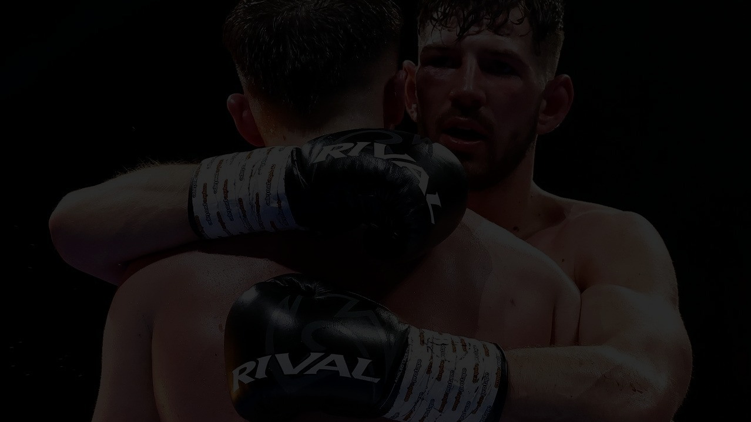
MEASUREMENT & ACCOUNTABILITY
EVERY OUTPUT, MEASURED
Every element of public support maps to a measurable output, an agreed method and a reporting date.
METRIC | METHOD | TIMING
International visitors | Ticket postcode/country + survey | Post-event
Visitor nights | Hotel/package data + survey | Post-event
Local procurement | Supplier ledger | 30 days
Local jobs/roles | Payroll & contractor records | 30 days
Broadcast reach | Broadcaster/platform reports | 30–60 days
Digital reach | Platform analytics | 7–30 days
Tax / fee receipts | Relevant authority data | Post-event
ELITE SPORTS PROMOTIONS × MARITA GROUP — NIGHT OF CHAMPIONS · RABAT

Slide 17
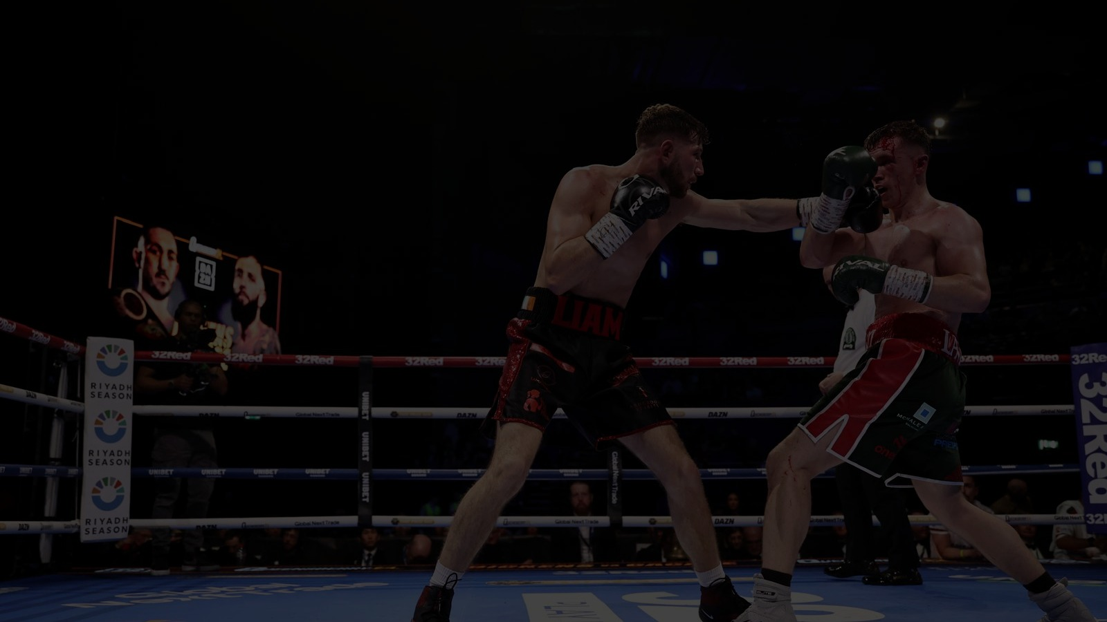
EMPLOYMENT & PROCUREMENT
KEEPING EVENT SPEND IN MOROCCO
01
PRODUCTION
02
HOSPITALITY
03
MOBILITY
Staging · lighting · sound · filming
Hotels · catering · venue services
Transfers · drivers · freight · local logistics
04
SECURITY
05
MARKETING
06
WORKFORCE
Stewarding · traffic · public-order coordination
Creative · media buying · PR · creators
1,000+ local roles — runners · technicians · event staff
LOCAL CONTENT AS A DESIGNED OUTCOME: procurement categories are identified before tendering — a local procurement target is set after budget validation, and actual Moroccan supplier spend is reported after the event.
ELITE SPORTS PROMOTIONS × MARITA GROUP — NIGHT OF CHAMPIONS · RABAT

Slide 18
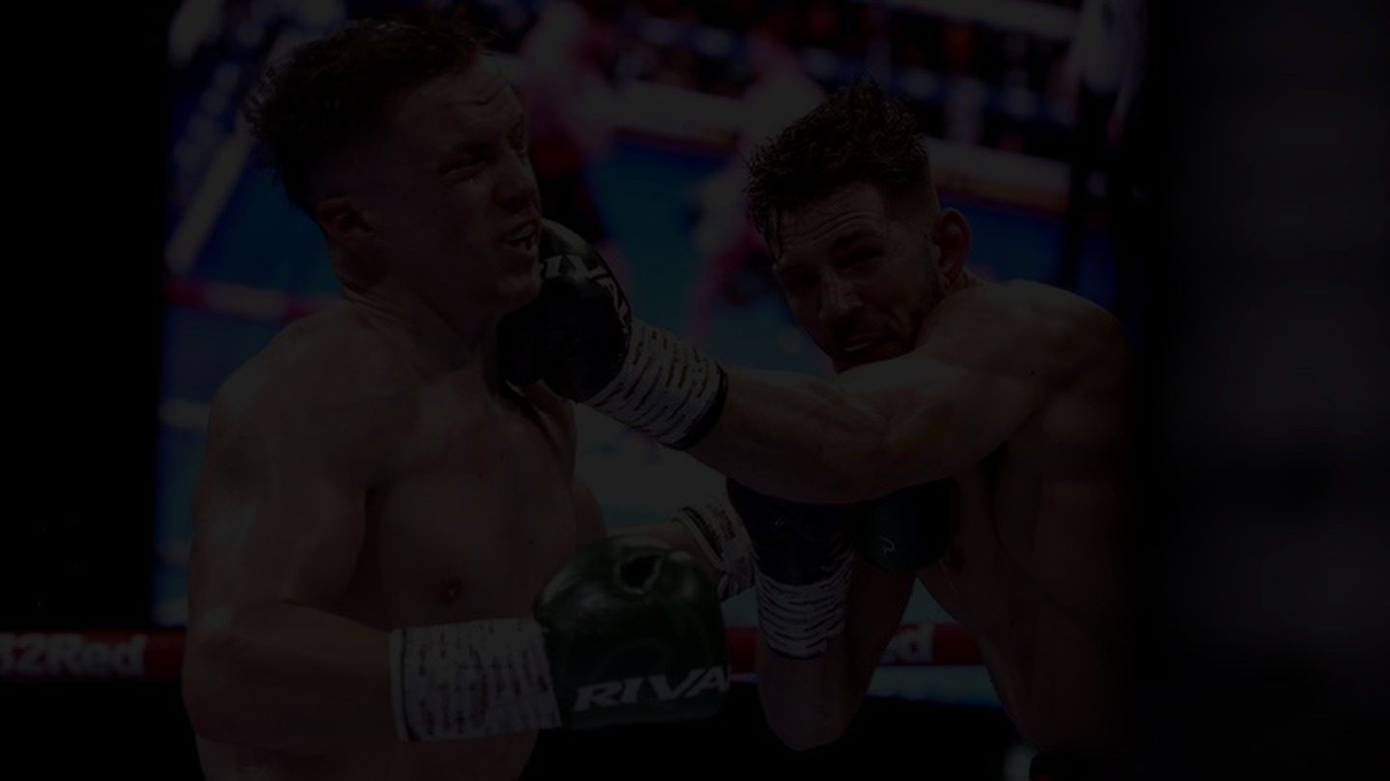
ELITE
THE RETURN FOR MOROCCO
WHAT THE KINGDOM RECEIVES
€25M
20,000+
100M+
1,000+
POTENTIAL DIRECT ECONOMIC IMPACT FOR THE RABAT REGION
VISITOR NIGHTS ACROSS RABAT'S HOTELS, RESTAURANTS AND VENUES
HOMES REACHED THROUGH INTERNATIONAL BROADCAST AND MEDIA
LOCAL ROLES ENGAGED ACROSS THE BUILD-UP AND SHOW WEEK
01
A GLOBAL SHOP WINDOW
02
TOURISM & HOSPITALITY UPLIFT
International broadcast puts Rabat's name, skyline and new national stadium in front of a worldwide audience — showcasing Morocco on the road to its co-hosted 2030 FIFA World Cup.
Travelling fight fans, a 200-strong international delegation for a week and fighters in camp for a month — filling hotels, restaurants, taxis and venues across the capital.
03
LOCAL JOBS & SUPPLIERS
04
A LEGACY PLATFORM
Production, staging, security, transport and marketing are contracted locally — Fixer Morocco, Stours Casablanca and a local marketing agency — with spending flowing straight into the Rabat economy.
The launch of PRO 3, a packed national stadium and a proven template for a recurring annual show — Rabat positioned as the fight capital of the region.
ELITE SPORTS PROMOTIONS × MARITA GROUP — NIGHT OF CHAMPIONS · RABAT
IMPACT FIGURES ARE UPPER-SIDE PLANNING ESTIMATES

Slide 19
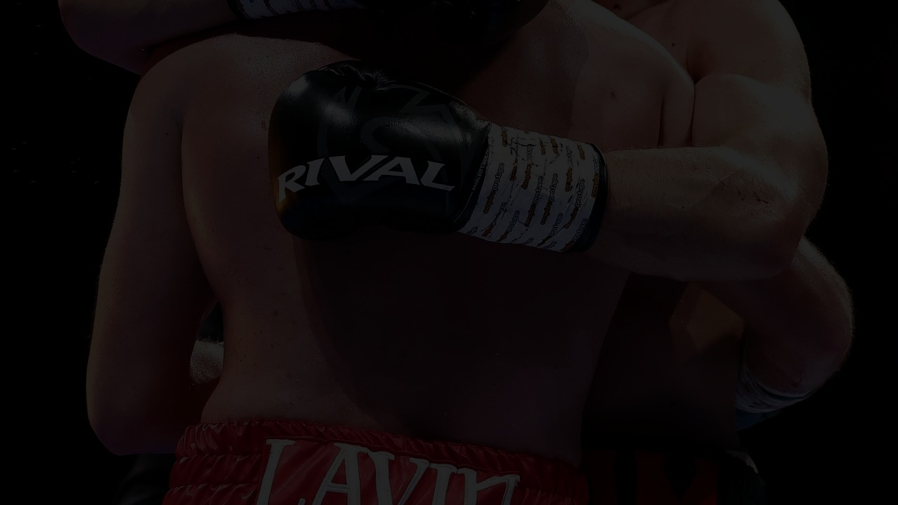
GOVERNANCE & SAFETY
ONE STRUCTURE. CLEAR ACCOUNTABILITY.
THE STEERING STRUCTURE
SAFETY & ASSURANCE FRAMEWORK
01
GOVERNMENT STEERING GROUP
Policy · public services · approvals
✓ CROWD — capacity, ingress/egress, stewarding, fan separation
02
EVENT EXECUTIVE
Elite × Marita × BiggCitty — budget · programme · commercial
✓ MEDICAL — ringside teams, stadium medical plan, hospital pathways
✓ SECURITY — athlete security, public order, command structure
03
VENUE & CITY OPS
Stadium · police · traffic · transport · medical
✓ INSURANCE — event, cancellation, liability and participant cover
04
COMMERCIAL & MEDIA
Broadcast · sponsors · ticketing · tourism
✓ CONTINGENCY — weather, artist/fighter withdrawal, evacuation
05
ASSURANCE
Insurance · legal · safety · independent reporting
✓ COMPLIANCE — sanctioning, visas, labour, tax, music rights, permits
ELITE SPORTS PROMOTIONS × MARITA GROUP — NIGHT OF CHAMPIONS · RABAT

Slide 20
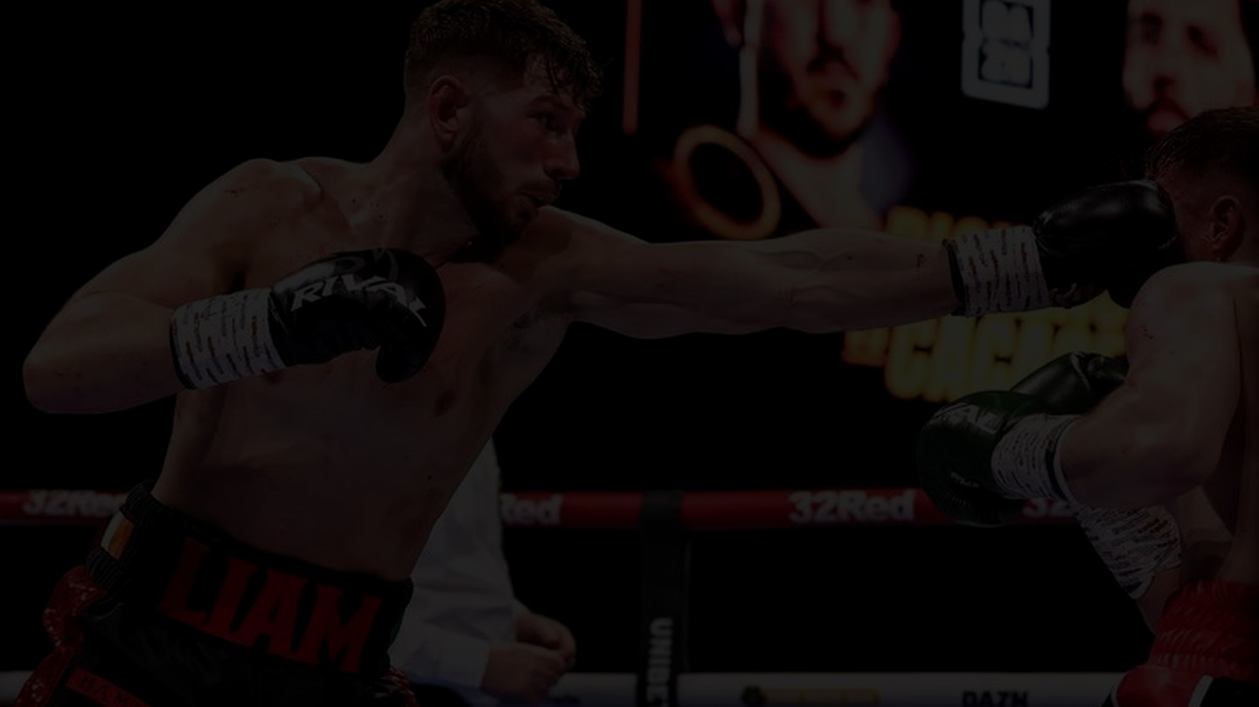
DELIVERY ROADMAP
T-6 MONTHS TO FIGHT NIGHT (MARCH 13th)
T-6
Working group, site inspection, MOU — Government working group formed · stadium and camp feasibility · memorandum of understanding
T-5
Contracts and commitments — sanctioning confirmed · budget lock · fighter and artist contracting · broadcast letters of intent
T-5-4
Commercial build — sponsor sales · production design · ticket strategy · official tourism packages
T-4-2
Public launch — international marketing campaign · operational planning with venue and city services
T-1
Camp opens — fighters and teams on site in Rabat · daily content · media activation begins
EVENT WEEK
Fight night — press conference · weigh-in · 13-bout card · stadium music finale · immediate KPI reporting
ELITE SPORTS PROMOTIONS × MARITA GROUP — NIGHT OF CHAMPIONS · RABAT

Slide 21
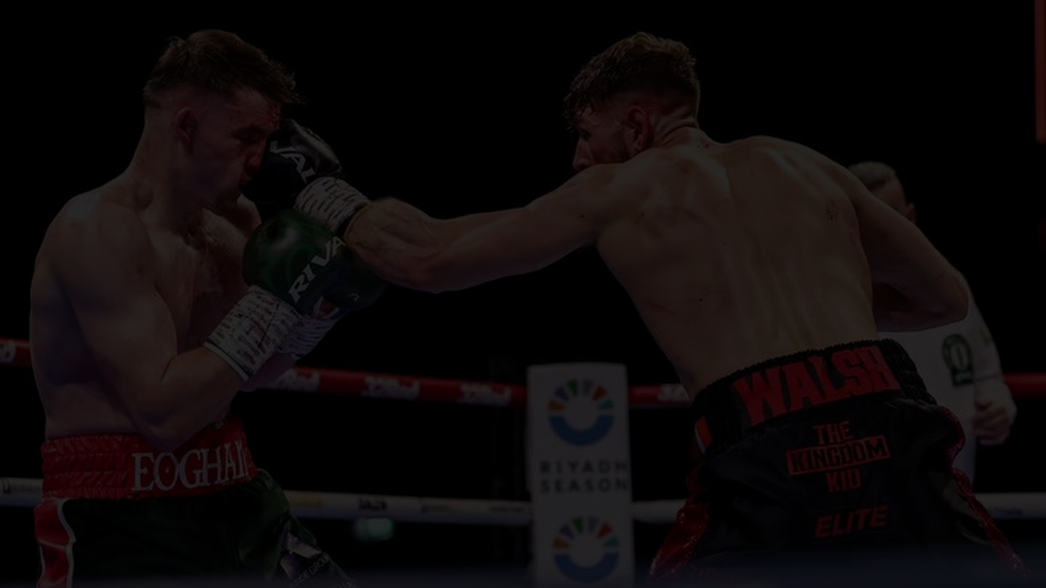
RISK REGISTER
THE DOWNSIDE, MADE VISIBLE
A credible proposal shows how value is protected if assumptions do not hold.
RISK | MITIGATION
Artist / fighter availability | Contract early · named alternates · cancellation terms
Ticket demand | Phased on-sale · price elasticity · marketing triggers
Broadcast not contracted | Approval gates tied to minimum distribution commitments
Cost inflation / FX | Contingency provision · fixed-price packages where possible
Security / geopolitical disruption | Joint risk assessment · insurance · cancellation protocol
Economic-impact overstatement | Independent methodology · actuals reported after the event
ELITE SPORTS PROMOTIONS × MARITA GROUP — NIGHT OF CHAMPIONS · RABAT

Slide 22
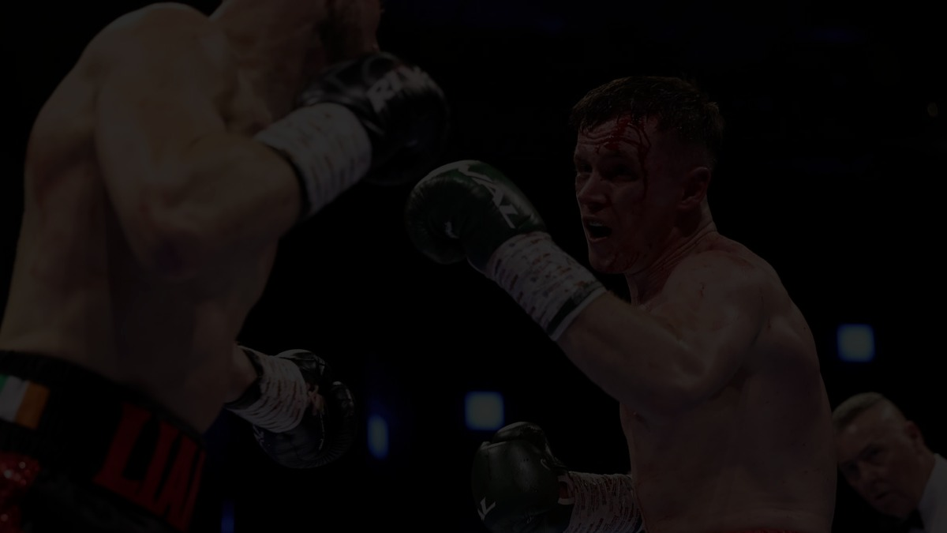
ELITE
THE PARTNERSHIP
WHAT WE ASK OF THE KINGDOM
Prince Moulay Abdellah Stadium — use of the stadium, including security and stewarding
Insurance partner — a Moroccan insurer to carry the show's event cover
Hotel accommodation — 200 rooms for fighters, teams and production (proposal: a premium Rabat hotel)
Local police support — traffic, crowd movement and public order around the stadium
Royal Air Maroc flights — 200 returns: 100 business, 100 premium economy
Local medical support — complementing our three paramedic crews, each with a senior paramedic
Introductions — to Moroccan broadcasters and the named sponsorship companies
PROPOSED ENGAGEMENT
Minister of Sports — Mohamed Saad Berrada · Minister of Tourism — Fatim-Zahra Ammor
With the Marita Group facilitating introductions at the appropriate level
ELITE SPORTS PROMOTIONS × MARITA GROUP — NIGHT OF CHAMPIONS · RABAT

Slide 23
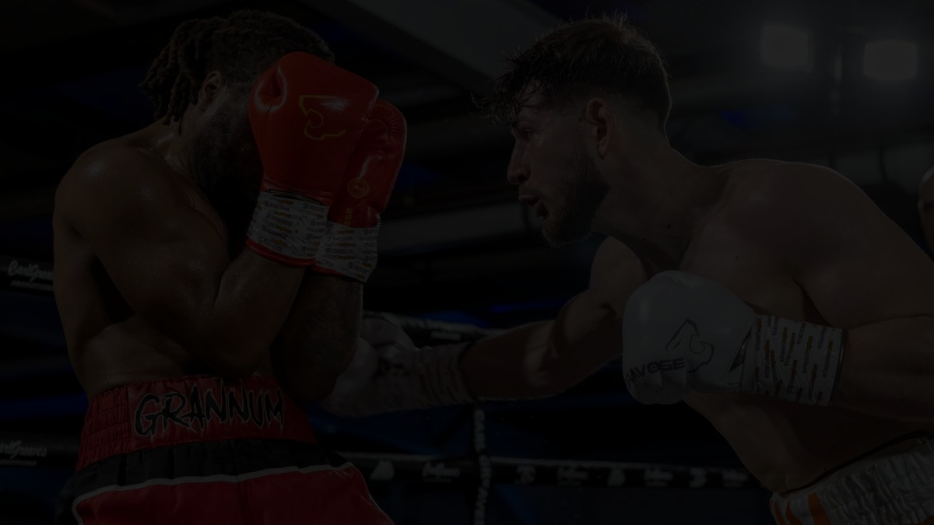
ELITE
DELIVERY & OPERATIONS
WHO DELIVERS WHAT
ELITE DELIVERS
MARITA GROUP ENABLES
LOCAL PARTNERS EXECUTE
— The full fight card and fighter contracts
— International broadcast — in talks with multiple major broadcasters
— Event production with BiggCitty Productions (Donteboss.com)
— Dedicated security for boxers and ringside
— BUI officials to sanction and officiate
— World exclusive of the anticipated PRO 3 Boxing debut
— Direct Government relationships and funding support
— Access to stadium, aviation and hospitality decision-makers
— Pathways to Morocco's leading corporate sponsors
— Fixer Morocco: stadium production and filming
— Stours Casablanca: accommodation, transfers, security logistics
— Local marketing company: on-the-ground campaign
LOGISTICS BASE: 200 rooms at a premium Rabat hotel · 200 Royal Air Maroc returns (100 business / 100 premium economy) · fighters and teams in camp at the stadium for four weeks
ELITE SPORTS PROMOTIONS × MARITA GROUP — NIGHT OF CHAMPIONS · RABAT

Slide 24
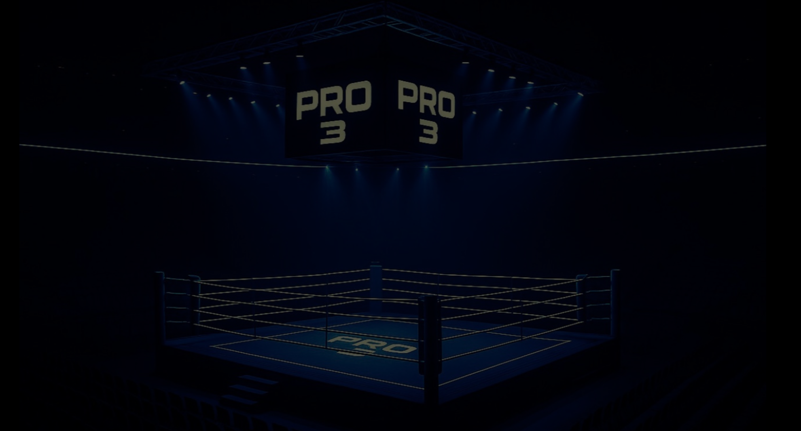
NEXT STEPS
01 · Site inspection of Prince Moulay Abdellah Stadium facilities and camp accommodation
02 · Memorandum of understanding with Government stakeholders, via the Marita Group
03 · Broadcast and sponsorship introductions — then announcement, on-sale and the four-week camp
LET'S GIVE RABAT A NIGHT
THE WORLD WILL REMEMBER.
PROMOTED BY ELITE SPORTS PROMOTIONS & MARITA GROUP
NIGHT OF CHAMPIONS · RABAT

